Slide 1
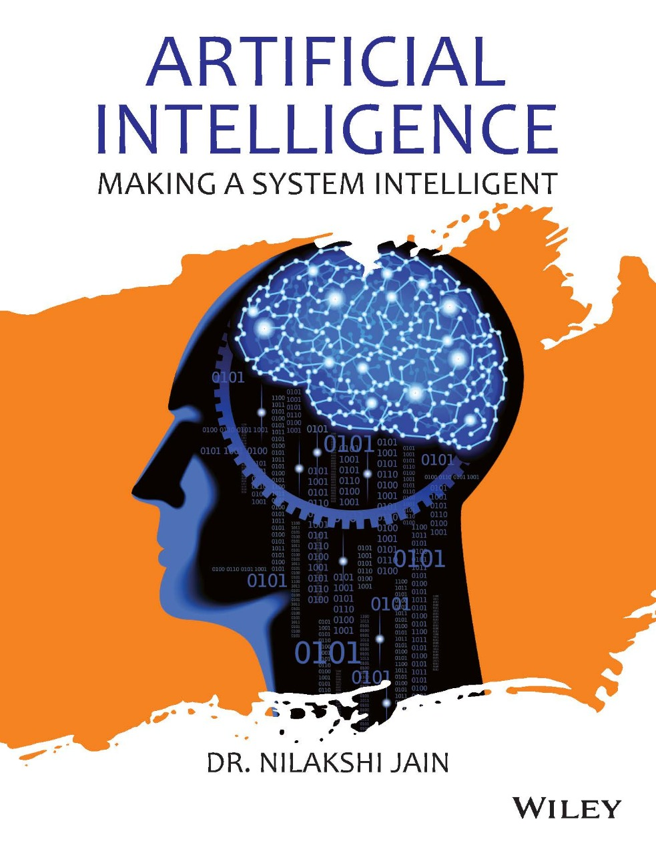
Chapter Eighteen
Artificial Neural Network

Slide 2
18.1 Introduction 18.2 Basic Models of Artificial Neural Networks 18.3 First Artificial Neurons: McCulloch-Pitts Model 18.4 Neural Network Architecture 18.5 Single-Layer Feed-forward ANN 18.6 Multilayer Feed-forward ANN 18.7 Activation Functions 18.8 Supervised Learning 18.9 Delta Learning Rule 18.10 Back propagation Algorithm 18.11 Unsupervised Learning Algorithm 18.12 Self-Organising Maps 18.13 Hybrid Approach : Fuzzy Neural Systems
Learning Objectives
After reading this chapter, students would be able to:
• Learn and understand different basic models of artificial neural networks and important terminologies of ANNs.
• Understand the concept of supervised learning and unsupervised learning.
• Read the fundamental of hybrid approach-Fuzzy Neural Systems.

Slide 3
18.1 Introduction 18.2 Basic Models of Artificial Neural Networks 18.3 First Artificial Neurons: McCulloch-Pitts Model 18.4 Neural Network Architecture 18.5 Single-Layer Feed-forward ANN 18.6 Multilayer Feed-forward ANN 18.7 Activation Functions 18.8 Supervised Learning 18.9 Delta Learning Rule 18.10 Back propagation Algorithm 18.11 Unsupervised Learning Algorithm 18.12 Self-Organising Maps 18.13 Hybrid Approach : Fuzzy Neural Systems
Introduction
Dr. Robert Hecht-Nielsen, the inventor of the first neuro-computer, defines the neural network as “... a computing system made up of a number of simple, highly interconnected processing elements, which process information by their dynamic state response to external inputs.”
In data technology (IT), a system of hardware and/or software package patterned in the case of the operation
of neurons within the human brain might be termed as neural network.
Additionally, neural networks are also known as artificial neural networks. It is the square measure, a spread of deep learning technology which can be grouped under AI. Commercial applications of such technologies specialize typically in resolution-complicated signal process or pattern recognition issues . Since 2000, examples of major business applications embrace handwriting recognition for check process ,speech-to-text transcription, oil-exploration knowledge analysis, weather prediction and face recognition.

Slide 4
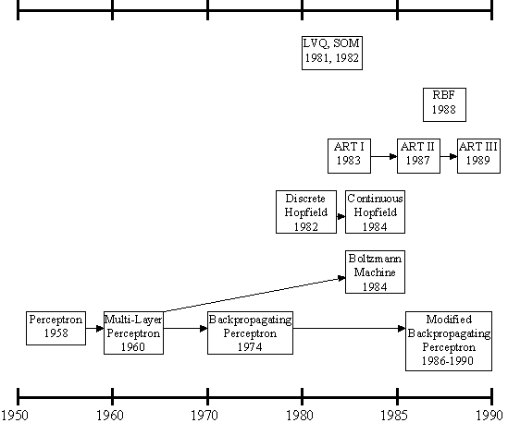
History of the Artificial Neural Networks
18.1 Introduction 18.2 Basic Models of Artificial Neural Networks 18.3 First Artificial Neurons: McCulloch-Pitts Model 18.4 Neural Network Architecture 18.5 Single-Layer Feed-forward ANN 18.6 Multilayer Feed-forward ANN 18.7 Activation Functions 18.8 Supervised Learning 18.9 Delta Learning Rule 18.10 Back propagation Algorithm 18.11 Unsupervised Learning Algorithm 18.12 Self-Organising Maps 18.13 Hybrid Approach : Fuzzy Neural Systems
history of the ANNs stems from the 1940s, the decade of the first electronic computer.
However, the first important step took place in 1957 when Rosenblatt introduced the first concrete neural model, the perceptron. Rosenblatt also took part in constructing the first successful neurocomputer, the Mark I Perceptron. After this, the development of ANNs has proceeded as described in Figure.

Slide 5
18.1 Introduction 18.2 Basic Models of Artificial Neural Networks 18.3 First Artificial Neurons: McCulloch-Pitts Model 18.4 Neural Network Architecture 18.5 Single-Layer Feed-forward ANN 18.6 Multilayer Feed-forward ANN 18.7 Activation Functions 18.8 Supervised Learning 18.9 Delta Learning Rule 18.10 Back propagation Algorithm 18.11 Unsupervised Learning Algorithm 18.12 Self-Organising Maps 18.13 Hybrid Approach : Fuzzy Neural Systems
History of the Artificial Neural Networks
Rosenblatt's original perceptron model contained only one layer. From this, a multi-layered model was derived in 1960. At first, the use of the multi-layer perceptron (MLP) was complicated by the lack of a appropriate learning algorithm.
In 1974, Werbos came to introduce a so-called backpropagation algorithm for the three-layered perceptron network.

Slide 6
18.1 Introduction 18.2 Basic Models of Artificial Neural Networks 18.3 First Artificial Neurons: McCulloch-Pitts Model 18.4 Neural Network Architecture 18.5 Single-Layer Feed-forward ANN 18.6 Multilayer Feed-forward ANN 18.7 Activation Functions 18.8 Supervised Learning 18.9 Delta Learning Rule 18.10 Back propagation Algorithm 18.11 Unsupervised Learning Algorithm 18.12 Self-Organising Maps 18.13 Hybrid Approach : Fuzzy Neural Systems
History of the Artificial Neural Networks
in 1986, The application area of the MLP networks remained rather limited until the breakthrough when a general back propagation algorithm for a multi-layered perceptron was introduced by Rummelhart and Mclelland.
in 1982, Hopfield brought out his idea of a neural network. Unlike the neurons in MLP, the Hopfield network consists of only one layer whose neurons are fully connected with each other.

Slide 7
18.1 Introduction 18.2 Basic Models of Artificial Neural Networks 18.3 First Artificial Neurons: McCulloch-Pitts Model 18.4 Neural Network Architecture 18.5 Single-Layer Feed-forward ANN 18.6 Multilayer Feed-forward ANN 18.7 Activation Functions 18.8 Supervised Learning 18.9 Delta Learning Rule 18.10 Back propagation Algorithm 18.11 Unsupervised Learning Algorithm 18.12 Self-Organising Maps 18.13 Hybrid Approach : Fuzzy Neural Systems
History of the Artificial Neural Networks
Since then, new versions of the Hopfield network have been developed. The Boltzmann machine has been influenced by both the Hopfield network and the MLP.

Slide 8
18.1 Introduction 18.2 Basic Models of Artificial Neural Networks 18.3 First Artificial Neurons: McCulloch-Pitts Model 18.4 Neural Network Architecture 18.5 Single-Layer Feed-forward ANN 18.6 Multilayer Feed-forward ANN 18.7 Activation Functions 18.8 Supervised Learning 18.9 Delta Learning Rule 18.10 Back propagation Algorithm 18.11 Unsupervised Learning Algorithm 18.12 Self-Organising Maps 18.13 Hybrid Approach : Fuzzy Neural Systems
History of the Artificial Neural Networks
in 1988, Radial Basis Function (RBF) networks were first introduced by Broomhead & Lowe. Although the basic idea of RBF was developed 30 years ago under the name method of potential function, the work by Broomhead & Lowe opened a new frontier in the neural network community.

Slide 9
18.1 Introduction 18.2 Basic Models of Artificial Neural Networks 18.3 First Artificial Neurons: McCulloch-Pitts Model 18.4 Neural Network Architecture 18.5 Single-Layer Feed-forward ANN 18.6 Multilayer Feed-forward ANN 18.7 Activation Functions 18.8 Supervised Learning 18.9 Delta Learning Rule 18.10 Back propagation Algorithm 18.11 Unsupervised Learning Algorithm 18.12 Self-Organising Maps 18.13 Hybrid Approach : Fuzzy Neural Systems
History of the Artificial Neural Networks
in 1982, A totally unique kind of network model is the Self-Organizing Map (SOM) introduced by Kohonen. SOM is a certain kind of topological map which organizes itself based on the input patterns that it is trained with. The SOM originated from the LVQ (Learning Vector Quantization) network the underlying idea of which was also Kohonen's in 1972.

Slide 10
18.1 Introduction 18.2 Basic Models of Artificial Neural Networks 18.3 First Artificial Neurons: McCulloch-Pitts Model 18.4 Neural Network Architecture 18.5 Single-Layer Feed-forward ANN 18.6 Multilayer Feed-forward ANN 18.7 Activation Functions 18.8 Supervised Learning 18.9 Delta Learning Rule 18.10 Back propagation Algorithm 18.11 Unsupervised Learning Algorithm 18.12 Self-Organising Maps 18.13 Hybrid Approach : Fuzzy Neural Systems
History of Artificial Neural Networks
Since then, research on artificial neural networks has remained active, leading to many new network types, as well as hybrid algorithms and hardware for neural information processing.

Slide 11
18.1 Introduction 18.2 Basic Models of Artificial Neural Networks 18.3 First Artificial Neurons: McCulloch-Pitts Model 18.4 Neural Network Architecture 18.5 Single-Layer Feed-forward ANN 18.6 Multilayer Feed-forward ANN 18.7 Activation Functions 18.8 Supervised Learning 18.9 Delta Learning Rule 18.10 Back propagation Algorithm 18.11 Unsupervised Learning Algorithm 18.12 Self-Organising Maps 18.13 Hybrid Approach : Fuzzy Neural Systems
Artificial Neural Network
An artificial neural network consists of a pool of simple processing units which communicate by sending signals to each other over a large number of weighted connections.

Slide 12
18.1 Introduction 18.2 Basic Models of Artificial Neural Networks 18.3 First Artificial Neurons: McCulloch-Pitts Model 18.4 Neural Network Architecture 18.5 Single-Layer Feed-forward ANN 18.6 Multilayer Feed-forward ANN 18.7 Activation Functions 18.8 Supervised Learning 18.9 Delta Learning Rule 18.10 Back propagation Algorithm 18.11 Unsupervised Learning Algorithm 18.12 Self-Organising Maps 18.13 Hybrid Approach : Fuzzy Neural Systems
Artificial Neural Network
A set of major aspects of a parallel distributed model include:
a set of processing units (cells).
a state of activation for every unit, which equivalent to the output of the unit.
connections between the units. Generally each connection is defined by a weight.
a propagation rule, which determines the effective input of a unit from its external inputs.
an activation function, which determines the new level of activation based on the effective input and the current activation.
an external input for each unit.
a method for information gathering (the learning rule).
an environment within which the system must operate, providing input signals and _ if necessary _ error signals.

Slide 13
18.1 Introduction 18.2 Basic Models of Artificial Neural Networks 18.3 First Artificial Neurons: McCulloch-Pitts Model 18.4 Neural Network Architecture 18.5 Single-Layer Feed-forward ANN 18.6 Multilayer Feed-forward ANN 18.7 Activation Functions 18.8 Supervised Learning 18.9 Delta Learning Rule 18.10 Back propagation Algorithm 18.11 Unsupervised Learning Algorithm 18.12 Self-Organising Maps 18.13 Hybrid Approach : Fuzzy Neural Systems
Computers vs. Neural Networks
“Standard” Computers Neural Networks
one CPU highly parallel processing
fast processing units slow processing units
reliable units unreliable units
static infrastructure dynamic infrastructure

Slide 14
18.1 Introduction 18.2 Basic Models of Artificial Neural Networks 18.3 First Artificial Neurons: McCulloch-Pitts Model 18.4 Neural Network Architecture 18.5 Single-Layer Feed-forward ANN 18.6 Multilayer Feed-forward ANN 18.7 Activation Functions 18.8 Supervised Learning 18.9 Delta Learning Rule 18.10 Back propagation Algorithm 18.11 Unsupervised Learning Algorithm 18.12 Self-Organising Maps 18.13 Hybrid Approach : Fuzzy Neural Systems
Why Artificial Neural Networks?
There are two basic reasons why we are interested in building artificial neural networks (ANNs):
Technical viewpoint: Some problems such as character recognition or the prediction of future states of a system require massively parallel and adaptive processing.
Biological viewpoint: ANNs can be used to replicate and simulate components of the human (or animal) brain, thereby giving us insight into natural information processing.

Slide 15
18.1 Introduction 18.2 Basic Models of Artificial Neural Networks 18.3 First Artificial Neurons: McCulloch-Pitts Model 18.4 Neural Network Architecture 18.5 Single-Layer Feed-forward ANN 18.6 Multilayer Feed-forward ANN 18.7 Activation Functions 18.8 Supervised Learning 18.9 Delta Learning Rule 18.10 Back propagation Algorithm 18.11 Unsupervised Learning Algorithm 18.12 Self-Organising Maps 18.13 Hybrid Approach : Fuzzy Neural Systems
Artificial Neural Networks
The “building blocks” of neural networks are the neurons.
In technical systems, we also refer to them as units or nodes.
Basically, each neuron
receives input from many other neurons.
changes its internal state (activation) based on the current input.
sends one output signal to many other neurons, possibly including its input neurons (recurrent network).

Slide 16
18.1 Introduction 18.2 Basic Models of Artificial Neural Networks 18.3 First Artificial Neurons: McCulloch-Pitts Model 18.4 Neural Network Architecture 18.5 Single-Layer Feed-forward ANN 18.6 Multilayer Feed-forward ANN 18.7 Activation Functions 18.8 Supervised Learning 18.9 Delta Learning Rule 18.10 Back propagation Algorithm 18.11 Unsupervised Learning Algorithm 18.12 Self-Organising Maps 18.13 Hybrid Approach : Fuzzy Neural Systems
Artificial Neural Networks
Information is transmitted as a series of electric impulses, so-called spikes.
The frequency and phase of these spikes encodes the information.
In biological systems, one neuron can be connected to as many as 10,000 other neurons.
Usually, a neuron receives its information from other neurons in a confined area, its so-called receptive field.

Slide 17

18.1 Introduction 18.2 Basic Models of Artificial Neural Networks 18.3 First Artificial Neurons: McCulloch-Pitts Model 18.4 Neural Network Architecture 18.5 Single-Layer Feed-forward ANN 18.6 Multilayer Feed-forward ANN 18.7 Activation Functions 18.8 Supervised Learning 18.9 Delta Learning Rule 18.10 Back propagation Algorithm 18.11 Unsupervised Learning Algorithm 18.12 Self-Organising Maps 18.13 Hybrid Approach : Fuzzy Neural Systems
How do ANNs work?
An artificial neural network (ANN) is either a hardware implementation or a computer program which strives to simulate the information processing capabilities of its biological exemplar. ANNs are typically composed of a great number of interconnected artificial neurons. The artificial neurons are simplified models of their biological counterparts.
ANN is a technique for solving problems by constructing software that works like our brains.

Slide 18
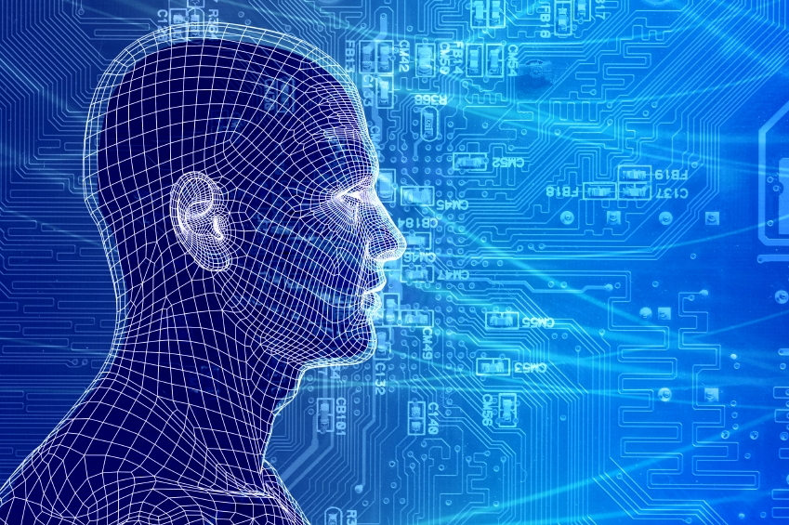
18.1 Introduction 18.2 Basic Models of Artificial Neural Networks 18.3 First Artificial Neurons: McCulloch-Pitts Model 18.4 Neural Network Architecture 18.5 Single-Layer Feed-forward ANN 18.6 Multilayer Feed-forward ANN 18.7 Activation Functions 18.8 Supervised Learning 18.9 Delta Learning Rule 18.10 Back propagation Algorithm 18.11 Unsupervised Learning Algorithm 18.12 Self-Organising Maps 18.13 Hybrid Approach : Fuzzy Neural Systems
How do our brains work?
The Brain is A massively parallel information processing system.
Our brains are a huge network of processing elements. A typical brain contains a network of 10 billion neurons.

Slide 19
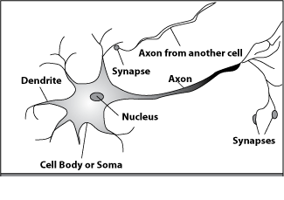
18.1 Introduction 18.2 Basic Models of Artificial Neural Networks 18.3 First Artificial Neurons: McCulloch-Pitts Model 18.4 Neural Network Architecture 18.5 Single-Layer Feed-forward ANN 18.6 Multilayer Feed-forward ANN 18.7 Activation Functions 18.8 Supervised Learning 18.9 Delta Learning Rule 18.10 Back propagation Algorithm 18.11 Unsupervised Learning Algorithm 18.12 Self-Organising Maps 18.13 Hybrid Approach : Fuzzy Neural Systems
How do our brains work?
A processing element
Dendrites: Input
Cell body: Processor
Synaptic: Link
Axon: Output

Slide 20
18.1 Introduction 18.2 Basic Models of Artificial Neural Networks 18.3 First Artificial Neurons: McCulloch-Pitts Model 18.4 Neural Network Architecture 18.5 Single-Layer Feed-forward ANN 18.6 Multilayer Feed-forward ANN 18.7 Activation Functions 18.8 Supervised Learning 18.9 Delta Learning Rule 18.10 Back propagation Algorithm 18.11 Unsupervised Learning Algorithm 18.12 Self-Organising Maps 18.13 Hybrid Approach : Fuzzy Neural Systems
How do our brains work?
A processing element
A neuron is connected to other neurons through about 10,000 synapses

Slide 21
18.1 Introduction 18.2 Basic Models of Artificial Neural Networks 18.3 First Artificial Neurons: McCulloch-Pitts Model 18.4 Neural Network Architecture 18.5 Single-Layer Feed-forward ANN 18.6 Multilayer Feed-forward ANN 18.7 Activation Functions 18.8 Supervised Learning 18.9 Delta Learning Rule 18.10 Back propagation Algorithm 18.11 Unsupervised Learning Algorithm 18.12 Self-Organising Maps 18.13 Hybrid Approach : Fuzzy Neural Systems
How do our brains work?
A processing element
A neuron receives input from other neurons. Inputs are combined.

Slide 22
18.1 Introduction 18.2 Basic Models of Artificial Neural Networks 18.3 First Artificial Neurons: McCulloch-Pitts Model 18.4 Neural Network Architecture 18.5 Single-Layer Feed-forward ANN 18.6 Multilayer Feed-forward ANN 18.7 Activation Functions 18.8 Supervised Learning 18.9 Delta Learning Rule 18.10 Back propagation Algorithm 18.11 Unsupervised Learning Algorithm 18.12 Self-Organising Maps 18.13 Hybrid Approach : Fuzzy Neural Systems
How do our brains work?
A processing element
Once input exceeds a critical level, the neuron discharges a spike ‐ an electrical pulse that travels from the body, down the axon, to the next neuron(s)

Slide 23
18.1 Introduction 18.2 Basic Models of Artificial Neural Networks 18.3 First Artificial Neurons: McCulloch-Pitts Model 18.4 Neural Network Architecture 18.5 Single-Layer Feed-forward ANN 18.6 Multilayer Feed-forward ANN 18.7 Activation Functions 18.8 Supervised Learning 18.9 Delta Learning Rule 18.10 Back propagation Algorithm 18.11 Unsupervised Learning Algorithm 18.12 Self-Organising Maps 18.13 Hybrid Approach : Fuzzy Neural Systems
How do our brains work?
A processing element
The axon endings almost touch the dendrites or cell body of the next neuron.

Slide 24
18.1 Introduction 18.2 Basic Models of Artificial Neural Networks 18.3 First Artificial Neurons: McCulloch-Pitts Model 18.4 Neural Network Architecture 18.5 Single-Layer Feed-forward ANN 18.6 Multilayer Feed-forward ANN 18.7 Activation Functions 18.8 Supervised Learning 18.9 Delta Learning Rule 18.10 Back propagation Algorithm 18.11 Unsupervised Learning Algorithm 18.12 Self-Organising Maps 18.13 Hybrid Approach : Fuzzy Neural Systems
How do our brains work?
A processing element
Transmission of an electrical signal from one neuron to the next is effected by neurotransmitters.

Slide 25
18.1 Introduction 18.2 Basic Models of Artificial Neural Networks 18.3 First Artificial Neurons: McCulloch-Pitts Model 18.4 Neural Network Architecture 18.5 Single-Layer Feed-forward ANN 18.6 Multilayer Feed-forward ANN 18.7 Activation Functions 18.8 Supervised Learning 18.9 Delta Learning Rule 18.10 Back propagation Algorithm 18.11 Unsupervised Learning Algorithm 18.12 Self-Organising Maps 18.13 Hybrid Approach : Fuzzy Neural Systems
How do our brains work?
A processing element
Neurotransmitters are chemicals which are released from the first neuron and which bind to the
Second.

Slide 26
18.1 Introduction 18.2 Basic Models of Artificial Neural Networks 18.3 First Artificial Neurons: McCulloch-Pitts Model 18.4 Neural Network Architecture 18.5 Single-Layer Feed-forward ANN 18.6 Multilayer Feed-forward ANN 18.7 Activation Functions 18.8 Supervised Learning 18.9 Delta Learning Rule 18.10 Back propagation Algorithm 18.11 Unsupervised Learning Algorithm 18.12 Self-Organising Maps 18.13 Hybrid Approach : Fuzzy Neural Systems
How do our brains work?
A processing element
This link is called a synapse. The strength of the signal that reaches the next neuron depends on factors such as the amount of neurotransmitter available.

Slide 27
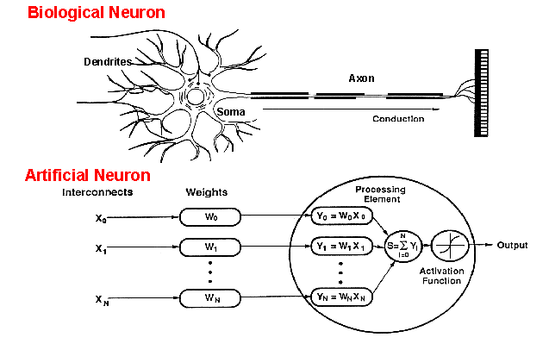
18.1 Introduction 18.2 Basic Models of Artificial Neural Networks 18.3 First Artificial Neurons: McCulloch-Pitts Model 18.4 Neural Network Architecture 18.5 Single-Layer Feed-forward ANN 18.6 Multilayer Feed-forward ANN 18.7 Activation Functions 18.8 Supervised Learning 18.9 Delta Learning Rule 18.10 Back propagation Algorithm 18.11 Unsupervised Learning Algorithm 18.12 Self-Organising Maps 18.13 Hybrid Approach : Fuzzy Neural Systems
How do ANNs work?
An artificial neuron is an imitation of a human neuron

Slide 28
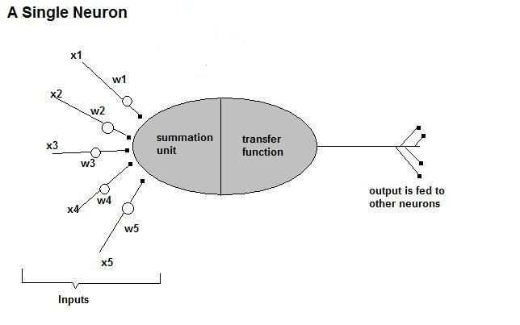
18.1 Introduction 18.2 Basic Models of Artificial Neural Networks 18.3 First Artificial Neurons: McCulloch-Pitts Model 18.4 Neural Network Architecture 18.5 Single-Layer Feed-forward ANN 18.6 Multilayer Feed-forward ANN 18.7 Activation Functions 18.8 Supervised Learning 18.9 Delta Learning Rule 18.10 Back propagation Algorithm 18.11 Unsupervised Learning Algorithm 18.12 Self-Organising Maps 18.13 Hybrid Approach : Fuzzy Neural Systems
How do ANNs work?
• Now, let us have a look at the model of an artificial neuron.

Slide 29
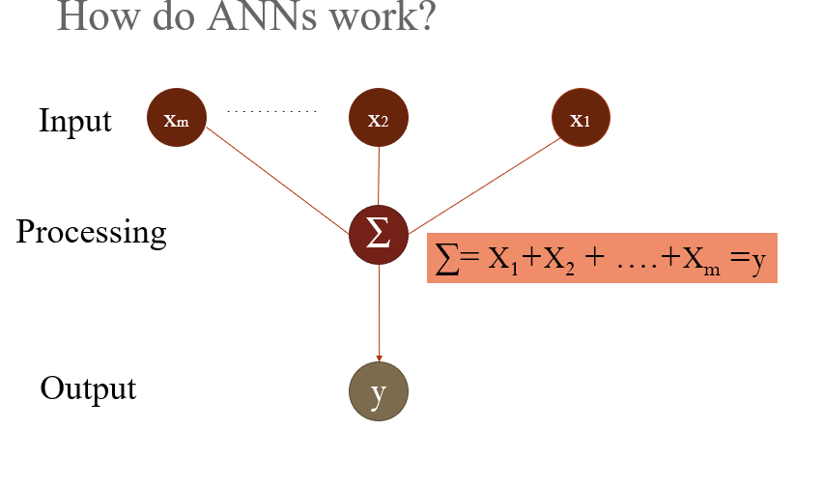
18.1 Introduction 18.2 Basic Models of Artificial Neural Networks 18.3 First Artificial Neurons: McCulloch-Pitts Model 18.4 Neural Network Architecture 18.5 Single-Layer Feed-forward ANN 18.6 Multilayer Feed-forward ANN 18.7 Activation Functions 18.8 Supervised Learning 18.9 Delta Learning Rule 18.10 Back propagation Algorithm 18.11 Unsupervised Learning Algorithm 18.12 Self-Organising Maps 18.13 Hybrid Approach : Fuzzy Neural Systems

Slide 30
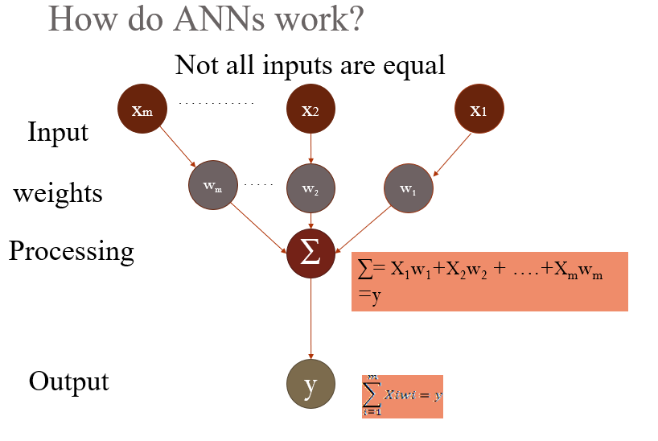
18.1 Introduction 18.2 Basic Models of Artificial Neural Networks 18.3 First Artificial Neurons: McCulloch-Pitts Model 18.4 Neural Network Architecture 18.5 Single-Layer Feed-forward ANN 18.6 Multilayer Feed-forward ANN 18.7 Activation Functions 18.8 Supervised Learning 18.9 Delta Learning Rule 18.10 Back propagation Algorithm 18.11 Unsupervised Learning Algorithm 18.12 Self-Organising Maps 18.13 Hybrid Approach : Fuzzy Neural Systems

Slide 31
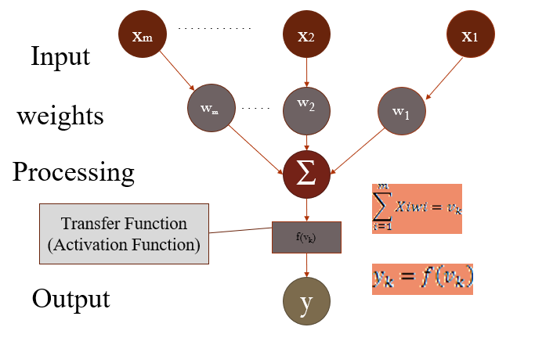
18.1 Introduction 18.2 Basic Models of Artificial Neural Networks 18.3 First Artificial Neurons: McCulloch-Pitts Model 18.4 Neural Network Architecture 18.5 Single-Layer Feed-forward ANN 18.6 Multilayer Feed-forward ANN 18.7 Activation Functions 18.8 Supervised Learning 18.9 Delta Learning Rule 18.10 Back propagation Algorithm 18.11 Unsupervised Learning Algorithm 18.12 Self-Organising Maps 18.13 Hybrid Approach : Fuzzy Neural Systems
How do ANNs work?
The signal is not passed down to the
next neuron verbatim

Slide 32
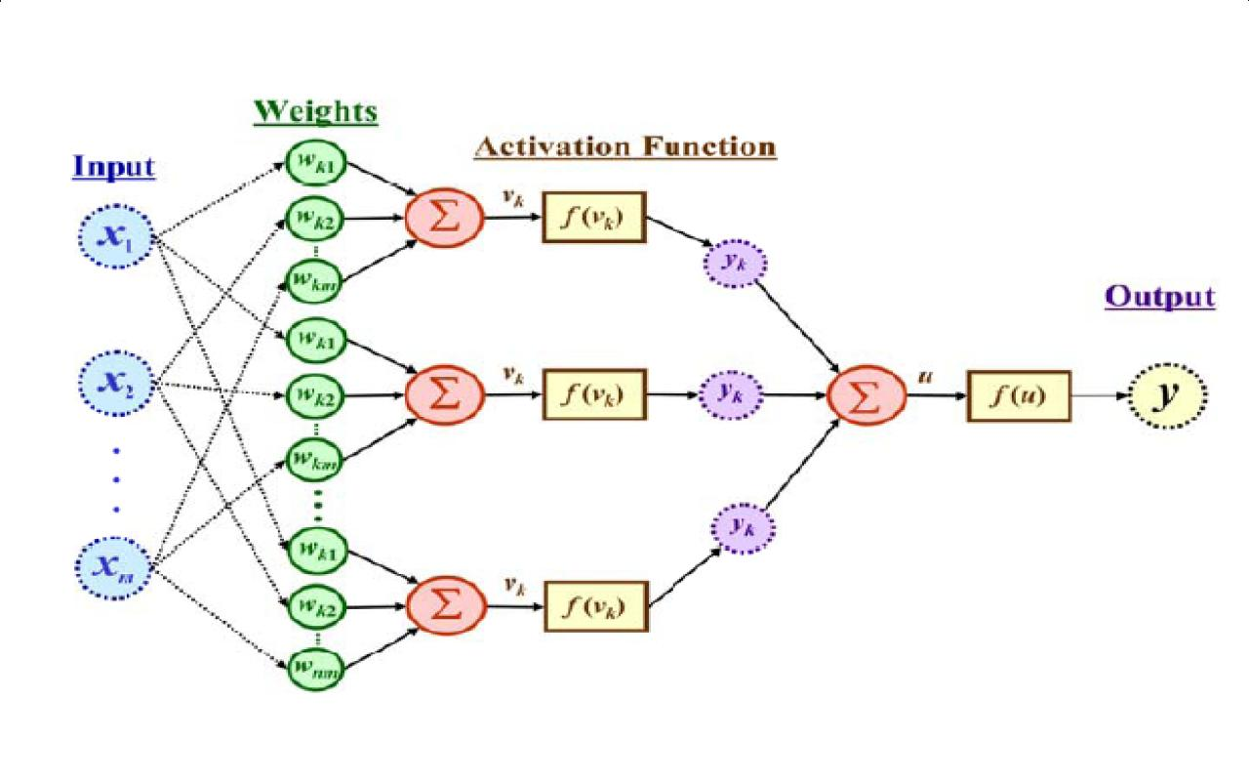
18.1 Introduction 18.2 Basic Models of Artificial Neural Networks 18.3 First Artificial Neurons: McCulloch-Pitts Model 18.4 Neural Network Architecture 18.5 Single-Layer Feed-forward ANN 18.6 Multilayer Feed-forward ANN 18.7 Activation Functions 18.8 Supervised Learning 18.9 Delta Learning Rule 18.10 Back propagation Algorithm 18.11 Unsupervised Learning Algorithm 18.12 Self-Organising Maps 18.13 Hybrid Approach : Fuzzy Neural Systems
The output is a function of the input, that is affected by the weights, and the transfer functions

Slide 33
18.1 Introduction 18.2 Basic Models of Artificial Neural Networks 18.3 First Artificial Neurons: McCulloch-Pitts Model 18.4 Neural Network Architecture 18.5 Single-Layer Feed-forward ANN 18.6 Multilayer Feed-forward ANN 18.7 Activation Functions 18.8 Supervised Learning 18.9 Delta Learning Rule 18.10 Back propagation Algorithm 18.11 Unsupervised Learning Algorithm 18.12 Self-Organising Maps 18.13 Hybrid Approach : Fuzzy Neural Systems
Artificial Neural Networks
An ANN can:
compute any computable function, by the appropriate selection of the network topology and weights values.
learn from experience!
Specifically, by trial‐and‐error

Slide 34
18.1 Introduction 18.2 Basic Models of Artificial Neural Networks 18.3 First Artificial Neurons: McCulloch-Pitts Model 18.4 Neural Network Architecture 18.5 Single-Layer Feed-forward ANN 18.6 Multilayer Feed-forward ANN 18.7 Activation Functions 18.8 Supervised Learning 18.9 Delta Learning Rule 18.10 Back propagation Algorithm 18.11 Unsupervised Learning Algorithm 18.12 Self-Organising Maps 18.13 Hybrid Approach : Fuzzy Neural Systems
Learning by trial‐and‐error
Continuous process of:
Trial:
Processing an input to produce an output (In terms of ANN: Compute the output function of a given input)
Evaluate:
Evaluating this output by comparing the actual output with the expected output.
Adjust:
Adjust the weights.

Slide 35
18.1 Introduction 18.2 Basic Models of Artificial Neural Networks 18.3 First Artificial Neurons: McCulloch-Pitts Model 18.4 Neural Network Architecture 18.5 Single-Layer Feed-forward ANN 18.6 Multilayer Feed-forward ANN 18.7 Activation Functions 18.8 Supervised Learning 18.9 Delta Learning Rule 18.10 Back propagation Algorithm 18.11 Unsupervised Learning Algorithm 18.12 Self-Organising Maps 18.13 Hybrid Approach : Fuzzy Neural Systems
How it works?
Set initial values of the weights randomly.
Input: truth table of the XOR
Do
Read input (e.g. 0, and 0)
Compute an output (e.g. 0.60543)
Compare it to the expected output. (Diff= 0.60543)
Modify the weights accordingly.
Loop until a condition is met
Condition: certain number of iterations
Condition: error threshold

Slide 36
18.1 Introduction 18.2 Basic Models of Artificial Neural Networks 18.3 First Artificial Neurons: McCulloch-Pitts Model 18.4 Neural Network Architecture 18.5 Single-Layer Feed-forward ANN 18.6 Multilayer Feed-forward ANN 18.7 Activation Functions 18.8 Supervised Learning 18.9 Delta Learning Rule 18.10 Back propagation Algorithm 18.11 Unsupervised Learning Algorithm 18.12 Self-Organising Maps 18.13 Hybrid Approach : Fuzzy Neural Systems
Design Issues
Initial weights (small random values ∈[‐1,1])
Transfer function (How the inputs and the weights are combined to produce output?)
Error estimation
Weights adjusting
Number of neurons
Data representation
Size of training set

Slide 37
18.1 Introduction 18.2 Basic Models of Artificial Neural Networks 18.3 First Artificial Neurons: McCulloch-Pitts Model 18.4 Neural Network Architecture 18.5 Single-Layer Feed-forward ANN 18.6 Multilayer Feed-forward ANN 18.7 Activation Functions 18.8 Supervised Learning 18.9 Delta Learning Rule 18.10 Back propagation Algorithm 18.11 Unsupervised Learning Algorithm 18.12 Self-Organising Maps 18.13 Hybrid Approach : Fuzzy Neural Systems
Transfer Functions
Linear: The output is proportional to the total weighted input.
Threshold: The output is set at one of two values, depending on whether the total weighted input is greater than or less than some threshold value.
Non‐linear: The output varies continuously but not linearly as the input changes.

Slide 38
18.1 Introduction 18.2 Basic Models of Artificial Neural Networks 18.3 First Artificial Neurons: McCulloch-Pitts Model 18.4 Neural Network Architecture 18.5 Single-Layer Feed-forward ANN 18.6 Multilayer Feed-forward ANN 18.7 Activation Functions 18.8 Supervised Learning 18.9 Delta Learning Rule 18.10 Back propagation Algorithm 18.11 Unsupervised Learning Algorithm 18.12 Self-Organising Maps 18.13 Hybrid Approach : Fuzzy Neural Systems
Error Estimation
The root mean square error (RMSE) is a frequently-used measure of the differences between values predicted by a model or an estimator and the values actually observed from the thing being modeled or estimated

Slide 39
18.1 Introduction 18.2 Basic Models of Artificial Neural Networks 18.3 First Artificial Neurons: McCulloch-Pitts Model 18.4 Neural Network Architecture 18.5 Single-Layer Feed-forward ANN 18.6 Multilayer Feed-forward ANN 18.7 Activation Functions 18.8 Supervised Learning 18.9 Delta Learning Rule 18.10 Back propagation Algorithm 18.11 Unsupervised Learning Algorithm 18.12 Self-Organising Maps 18.13 Hybrid Approach : Fuzzy Neural Systems
Weights Adjusting
After each iteration, weights should be adjusted to minimize the error.
– All possible weights
– Back propagation

Slide 40
18.1 Introduction 18.2 Basic Models of Artificial Neural Networks 18.3 First Artificial Neurons: McCulloch-Pitts Model 18.4 Neural Network Architecture 18.5 Single-Layer Feed-forward ANN 18.6 Multilayer Feed-forward ANN 18.7 Activation Functions 18.8 Supervised Learning 18.9 Delta Learning Rule 18.10 Back propagation Algorithm 18.11 Unsupervised Learning Algorithm 18.12 Self-Organising Maps 18.13 Hybrid Approach : Fuzzy Neural Systems
Back Propagation
Back-propagation is an example of supervised learning is used at each layer to minimize the error between the layer’s response and the actual data
The error at each hidden layer is an average of the evaluated error
Hidden layer networks are trained this way

Slide 41
18.1 Introduction 18.2 Basic Models of Artificial Neural Networks 18.3 First Artificial Neurons: McCulloch-Pitts Model 18.4 Neural Network Architecture 18.5 Single-Layer Feed-forward ANN 18.6 Multilayer Feed-forward ANN 18.7 Activation Functions 18.8 Supervised Learning 18.9 Delta Learning Rule 18.10 Back propagation Algorithm 18.11 Unsupervised Learning Algorithm 18.12 Self-Organising Maps 18.13 Hybrid Approach : Fuzzy Neural Systems
Back Propagation
N is a neuron.
N_{w} is one of N’s inputs weights
N_{out} is N’s output.
N_{w} = N_{w} +Δ N_{w}
Δ N_{w} = N_{out} * (1‐ N_{out})* N_{ErrorFactor}
N_{ErrorFactor} = N_{ExpectedOutput} – N_{ActualOutput}
This works only for the last layer, as we can know the actual output, and the expected output.

Slide 42
18.1 Introduction 18.2 Basic Models of Artificial Neural Networks 18.3 First Artificial Neurons: McCulloch-Pitts Model 18.4 Neural Network Architecture 18.5 Single-Layer Feed-forward ANN 18.6 Multilayer Feed-forward ANN 18.7 Activation Functions 18.8 Supervised Learning 18.9 Delta Learning Rule 18.10 Back propagation Algorithm 18.11 Unsupervised Learning Algorithm 18.12 Self-Organising Maps 18.13 Hybrid Approach : Fuzzy Neural Systems
Number of neurons
Many neurons:
Higher accuracy
Slower
Risk of over‐fitting
Memorizing, rather than understanding
The network will be useless with new problems.
Few neurons:
Lower accuracy
Inability to learn at all
Optimal number.

Slide 43
18.1 Introduction 18.2 Basic Models of Artificial Neural Networks 18.3 First Artificial Neurons: McCulloch-Pitts Model 18.4 Neural Network Architecture 18.5 Single-Layer Feed-forward ANN 18.6 Multilayer Feed-forward ANN 18.7 Activation Functions 18.8 Supervised Learning 18.9 Delta Learning Rule 18.10 Back propagation Algorithm 18.11 Unsupervised Learning Algorithm 18.12 Self-Organising Maps 18.13 Hybrid Approach : Fuzzy Neural Systems
Data representation
Usually input/output data needs pre‐processing
Pictures
Pixel intensity
Text:
A pattern

Slide 44
18.1 Introduction 18.2 Basic Models of Artificial Neural Networks 18.3 First Artificial Neurons: McCulloch-Pitts Model 18.4 Neural Network Architecture 18.5 Single-Layer Feed-forward ANN 18.6 Multilayer Feed-forward ANN 18.7 Activation Functions 18.8 Supervised Learning 18.9 Delta Learning Rule 18.10 Back propagation Algorithm 18.11 Unsupervised Learning Algorithm 18.12 Self-Organising Maps 18.13 Hybrid Approach : Fuzzy Neural Systems
Size of training set
No one‐fits‐all formula
Over fitting can occur if a “good” training set is not chosen
What constitutes a “good” training set?
Samples must represent the general population.
Samples must contain members of each class.
Samples in each class must contain a wide range of variations or noise effect.
The size of the training set is related to the number of hidden neurons

Slide 45
18.1 Introduction 18.2 Basic Models of Artificial Neural Networks 18.3 First Artificial Neurons: McCulloch-Pitts Model 18.4 Neural Network Architecture 18.5 Single-Layer Feed-forward ANN 18.6 Multilayer Feed-forward ANN 18.7 Activation Functions 18.8 Supervised Learning 18.9 Delta Learning Rule 18.10 Back propagation Algorithm 18.11 Unsupervised Learning Algorithm 18.12 Self-Organising Maps 18.13 Hybrid Approach : Fuzzy Neural Systems
Learning Paradigms
Supervised learning
Unsupervised learning
Reinforcement learning

Slide 46
18.1 Introduction 18.2 Basic Models of Artificial Neural Networks 18.3 First Artificial Neurons: McCulloch-Pitts Model 18.4 Neural Network Architecture 18.5 Single-Layer Feed-forward ANN 18.6 Multilayer Feed-forward ANN 18.7 Activation Functions 18.8 Supervised Learning 18.9 Delta Learning Rule 18.10 Back propagation Algorithm 18.11 Unsupervised Learning Algorithm 18.12 Self-Organising Maps 18.13 Hybrid Approach : Fuzzy Neural Systems
Supervised learning
This is what we have seen so far!
A network is fed with a set of training samples (inputs and corresponding output), and it uses these samples to learn the general relationship between the inputs and the outputs.
This relationship is represented by the values of the weights of the trained network.

Slide 47
18.1 Introduction 18.2 Basic Models of Artificial Neural Networks 18.3 First Artificial Neurons: McCulloch-Pitts Model 18.4 Neural Network Architecture 18.5 Single-Layer Feed-forward ANN 18.6 Multilayer Feed-forward ANN 18.7 Activation Functions 18.8 Supervised Learning 18.9 Delta Learning Rule 18.10 Back propagation Algorithm 18.11 Unsupervised Learning Algorithm 18.12 Self-Organising Maps 18.13 Hybrid Approach : Fuzzy Neural Systems
Unsupervised learning
No desired output is associated with the training data!
Faster than supervised learning
Used to find out structures within data:
Clustering
Compression

Slide 48
18.1 Introduction 18.2 Basic Models of Artificial Neural Networks 18.3 First Artificial Neurons: McCulloch-Pitts Model 18.4 Neural Network Architecture 18.5 Single-Layer Feed-forward ANN 18.6 Multilayer Feed-forward ANN 18.7 Activation Functions 18.8 Supervised Learning 18.9 Delta Learning Rule 18.10 Back propagation Algorithm 18.11 Unsupervised Learning Algorithm 18.12 Self-Organising Maps 18.13 Hybrid Approach : Fuzzy Neural Systems
Reinforcement learning
Like supervised learning, but:
Weights adjusting is not directly related to the error value.
The error value is used to randomly, shuffle weights!
Relatively slow learning due to ‘randomness’.

Slide 49
18.1 Introduction 18.2 Basic Models of Artificial Neural Networks 18.3 First Artificial Neurons: McCulloch-Pitts Model 18.4 Neural Network Architecture 18.5 Single-Layer Feed-forward ANN 18.6 Multilayer Feed-forward ANN 18.7 Activation Functions 18.8 Supervised Learning 18.9 Delta Learning Rule 18.10 Back propagation Algorithm 18.11 Unsupervised Learning Algorithm 18.12 Self-Organising Maps 18.13 Hybrid Approach : Fuzzy Neural Systems
Applications Areas
Function approximation
including time series prediction and modeling.
Classification
including patterns and sequences recognition, novelty detection and sequential decision making.
(radar systems, face identification, handwritten text recognition)
Data processing
including filtering, clustering blinds source separation and compression.
(data mining, e-mail Spam filtering)

Slide 50
18.1 Introduction 18.2 Basic Models of Artificial Neural Networks 18.3 First Artificial Neurons: McCulloch-Pitts Model 18.4 Neural Network Architecture 18.5 Single-Layer Feed-forward ANN 18.6 Multilayer Feed-forward ANN 18.7 Activation Functions 18.8 Supervised Learning 18.9 Delta Learning Rule 18.10 Back propagation Algorithm 18.11 Unsupervised Learning Algorithm 18.12 Self-Organising Maps 18.13 Hybrid Approach : Fuzzy Neural Systems
Advantages / Disadvantages
Advantages
Adapt to unknown situations
Powerful, it can model complex functions.
Ease of use, learns by example, and very little user domain‐specific expertise needed
Disadvantages
Forgets
Not exact
Large complexity of the network structure

Slide 51
18.1 Introduction 18.2 Basic Models of Artificial Neural Networks 18.3 First Artificial Neurons: McCulloch-Pitts Model 18.4 Neural Network Architecture 18.5 Single-Layer Feed-forward ANN 18.6 Multilayer Feed-forward ANN 18.7 Activation Functions 18.8 Supervised Learning 18.9 Delta Learning Rule 18.10 Back propagation Algorithm 18.11 Unsupervised Learning Algorithm 18.12 Self-Organising Maps 18.13 Hybrid Approach : Fuzzy Neural Systems
Basic Models Of Artificial Neural Network
There are many different ANN model. Main ones include the following:
1. Multilayer perceptron: It is a feed-forward ANN model. It maps set of input data onto a set of appropriate outputs.
2. Radial basis function network: A radial basis function network is an ANN. It uses radial basis functions as activation functions.
Both of the aforementioned models are being supervised by the learning networks used with one or
more dependent variables at the output.
3. The Kohonen network: It is an unsupervised learning network used for clustering.

Slide 52
18.1 Introduction 18.2 Basic Models of Artificial Neural Networks 18.3 First Artificial Neurons: McCulloch-Pitts Model 18.4 Neural Network Architecture 18.5 Single-Layer Feed-forward ANN 18.6 Multilayer Feed-forward ANN 18.7 Activation Functions 18.8 Supervised Learning 18.9 Delta Learning Rule 18.10 Back propagation Algorithm 18.11 Unsupervised Learning Algorithm 18.12 Self-Organising Maps 18.13 Hybrid Approach : Fuzzy Neural Systems
First Artificial Neurons : McColloch-Pitts Model
McCulloch–Pitts model was an exceptionally simple artificial neuron. The input received could either be zero or one, and the output might be zero or one. Also, each input might either be excitatory or inhibitory. Now, it was important to sum the inputs. If the input is one, and is excitatory in nature, one was added to it. And in case of output being one, and inhibitory, it subtracted one from the sum. This is performed for all the inputs, and the final received sum is calculated. Now, if the final sum received is less than the decided value, say T, then the output is zero. If in the aforementioned case, some other value is received, the output is a one. Graphical representation of McCulloch–Pitts model is shown in Figure 18.1.
Contd…

Slide 53
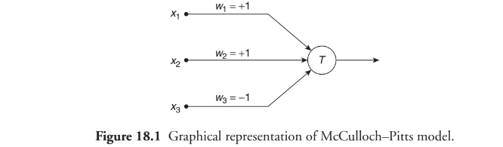
18.1 Introduction 18.2 Basic Models of Artificial Neural Networks 18.3 First Artificial Neurons: McCulloch-Pitts Model 18.4 Neural Network Architecture 18.5 Single-Layer Feed-forward ANN 18.6 Multilayer Feed-forward ANN 18.7 Activation Functions 18.8 Supervised Learning 18.9 Delta Learning Rule 18.10 Back propagation Algorithm 18.11 Unsupervised Learning Algorithm 18.12 Self-Organising Maps 18.13 Hybrid Approach : Fuzzy Neural Systems
.
First Artificial Neurons : McCulloch-Pitts Model

Slide 54
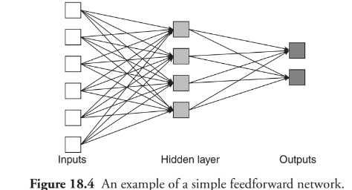
18.1 Introduction 18.2 Basic Models of Artificial Neural Networks 18.3 First Artificial Neurons: McCulloch-Pitts Model 18.4 Neural Network Architecture 18.5 Single-Layer Feed-forward ANN 18.6 Multilayer Feed-forward ANN 18.7 Activation Functions 18.8 Supervised Learning 18.9 Delta Learning Rule 18.10 Back propagation Algorithm 18.11 Unsupervised Learning Algorithm 18.12 Self-Organising Maps 18.13 Hybrid Approach : Fuzzy Neural Systems
Neural Network Architecture
18.4.1 Feed-Forward Networks:
In a feed-forward network ANNs (Figure 18.4), signals travel only in one way, that is, from input to output.
Cont….

Slide 55
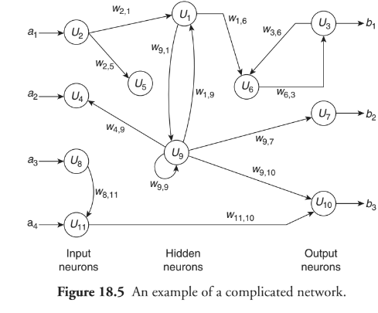
18.1 Introduction 18.2 Basic Models of Artificial Neural Networks 18.3 First Artificial Neurons: McCulloch-Pitts Model 18.4 Neural Network Architecture 18.5 Single-Layer Feed-forward ANN 18.6 Multilayer Feed-forward ANN 18.7 Activation Functions 18.8 Supervised Learning 18.9 Delta Learning Rule 18.10 Back propagation Algorithm 18.11 Unsupervised Learning Algorithm 18.12 Self-Organising Maps 18.13 Hybrid Approach : Fuzzy Neural Systems
18.4.2 Feedback Networks
Feedback networks (Figure 18.4) might have signals driving in both the directions by introduction of loops in the network. Feedback networks are too much powerful and might get complicated (Figure 18.5). The feedback networks are dynamic; however, their state changes frequently these reach the point of equilibrium.
Cont….
Neural Network Architecture

Slide 56
18.1 Introduction 18.2 Basic Models of Artificial Neural Networks 18.3 First Artificial Neurons: McCulloch-Pitts Model 18.4 Neural Network Architecture 18.5 Single-Layer Feed-forward ANN 18.6 Multilayer Feed-forward ANN 18.7 Activation Functions 18.8 Supervised Learning 18.9 Delta Learning Rule 18.10 Back propagation Algorithm 18.11 Unsupervised Learning Algorithm 18.12 Self-Organising Maps 18.13 Hybrid Approach : Fuzzy Neural Systems
Neural Network Architecture
18.4.3 Network Layers
The most common type of ANN has the following three groups, or layers, of units: a layer of input units is connected to a layer of hidden units, which is further connected to a layer of output units.
1. The activity performed by the input units shows the raw information fed into the network.
2. The activities of the input units determine the activity of each hidden unit and the weights on the connections between the input and the hidden units.
3. The activity of the hidden units and the weights between the hidden and output units depend on the behaviour of the output units.
18.4.4 Perceptrons
The significant work on neural nets in the 60s undergoes the heading known as perceptrons . It is a term coined by Frank Rosenblatt.
Cont….

Slide 57
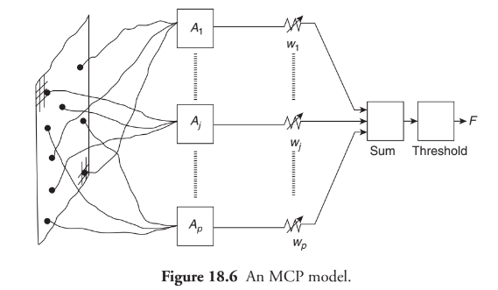
18.1 Introduction 18.2 Basic Models of Artificial Neural Networks 18.3 First Artificial Neurons: McCulloch-Pitts Model 18.4 Neural Network Architecture 18.5 Single-Layer Feed-forward ANN 18.6 Multilayer Feed-forward ANN 18.7 Activation Functions 18.8 Supervised Learning 18.9 Delta Learning Rule 18.10 Back propagation Algorithm 18.11 Unsupervised Learning Algorithm 18.12 Self-Organising Maps 18.13 Hybrid Approach : Fuzzy Neural Systems
Neural Network Architecture
18.4.4 Perceptrons
The perceptron (Figure 18.6) turns out to be an MCP model (neuron with weighted inputs) with some additional, fixed, preprocessing. Units labeled A₁, A₂, A_{j}, A_{p} are called association units and these perform the task of extracting specific and localised featured from the input images . Perceptrons mimic the general idea behind the mammalian visual system. These were majorly used in the pattern recognition although capabilities of these extended a lot more.

Slide 58
18.1 Introduction 18.2 Basic Models of Artificial Neural Networks 18.3 First Artificial Neurons: McCulloch-Pitts Model
18.4 Neural Network Architecture 18.5 Single Layer Feed-Forward ANN 18.6 Multilayer Feed-forward ANN 18.7 Activation Functions 18.8 Supervised Learning 18.9 Delta Learning Rule 18.10 Back propagation Algorithm 18.11 Unsupervised Learning Algorithm 18.12 Self-Organising Maps 18.13 Hybrid Approach : Fuzzy Neural Systems
Single Layer Feed-Forward ANN
A feed-forward neural network is an ANN in which connections between the units do not form a cycle. Also, it is too much different from the recurrent neural networks.
The first and simplest type of ANN devised was the feed-forward neural network. In this types of network, the movement of information is in one direction only, that is, forward, from the input nodes through the hidden nodes (if any) and to the output nodes. No cycles or loops can be found in the network.
The simplest type of neural network is a single-layer perceptron network, which has a single layer of output nodes and the inputs are directly fed into the outputs by a series of weights. Therefore, it can be said to be the simplest kind of feed-forward network.

Slide 59
18.1 Introduction 18.2 Basic Models of Artificial Neural Networks 18.3 First Artificial Neurons: McCulloch-Pitts Model 18.4 Neural Network Architecture 18.5 Single-Layer Feed-forward ANN Introduction 18.6 Multilayer Feed-Forward ANN 18.7 Activation Functions 18.8 Supervised Learning 18.9 Delta Learning Rule 18.10 Back propagation Algorithm 18.11 Unsupervised Learning Algorithm 18.12 Self-Organising Maps 18.13 Hybrid Approach : Fuzzy Neural Systems
Multilayer Feed-Forward ANN
An interconnection of perceptrons in which data and calculations flow in a single direction, that is, from the
input data to the outputs is known as multilayer feed-forward neural network. The number of layers in a neural
network is equivalent to the number of layers of perceptrons. The simplest of the neural network is defined to be the one with a single input layer and an output layer of perceptrons. The network in Figure 18.7
represents this kind of network. This is technically indicated to be a one-layer feed-forward network with two outputs since the output layer is the only layer with an activation calculation. Contd…

Slide 60
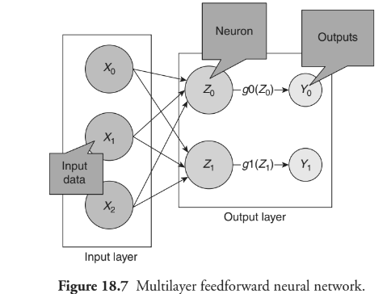
18.1 Introduction 18.2 Basic Models of Artificial Neural Networks 18.3 First Artificial Neurons: McCulloch-Pitts Model 18.4 Neural Network Architecture 18.5 Single-Layer Feed-forward ANN Introduction 18.6 Multilayer Feed-Forward ANN 18.7 Activation Functions 18.8 Supervised Learning 18.9 Delta Learning Rule 18.10 Back propagation Algorithm 18.11 Unsupervised Learning Algorithm 18.12 Self-Organising Maps 18.13 Hybrid Approach : Fuzzy Neural Systems
Multilayer Feed-Forward ANN

Slide 61

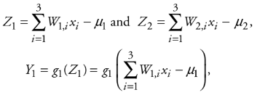
18.1 Introduction 18.2 Basic Models of Artificial Neural Networks 18.3 First Artificial Neurons: McCulloch-Pitts Model 18.4 Neural Network Architecture 18.5 Single-Layer Feed-forward ANN 18.6 Multilayer Feed-forward ANN 18.7 Activation Function 18.8 Supervised Learning 18.9 Delta Learning Rule 18.10 Back propagation Algorithm 18.11 Unsupervised Learning Algorithm 18.12 Self-Organising Maps 18.13 Hybrid Approach : Fuzzy Neural Systems
Activation Function
In activation functions single-layer feed-forward neural network, the inputs of the network are straightforward connected to the perceptrons of output layer, Z₁ and Z₂. The output perceptrons use activation functions, g₁ and g₂, to generate the outputs, Y₁ and Y₂.
As,
and

Slide 62
18.1 Introduction 18.2 Basic Models of Artificial Neural Networks 18.3 First Artificial Neurons: McCulloch-Pitts Model 18.4 Neural Network Architecture 18.5 Single-Layer Feed-forward ANN 18.6 Multilayer Feed-forward ANN 18.7 Activation Functions 18.8 Supervised Learning 18.9 Delta Learning Rule 18.10 Back propagation Algorithm 18.11 Unsupervised Learning Algorithm 18.12 Self-Organising Maps 18.13 Hybrid Approach : Fuzzy Neural Systems
Supervised Learning
In supervised learning, the inputs and the outputs both are given. Then, the network processes the inputs and compares its resulting outputs against the desired outputs. Errors are propagated back through the system, causing the system to accommodate the weights controlling the network. This process happens repeatedly as the weights are constantly tweaked. The set of data enabling the training is known as the training set. During the training of a network, same set of data is processed numerous times as the connection weights are ever refined . Currently, the commercial network development packages supplies the tools to get an understanding of how well an ANN is converging on the ability to assume the correct answer. These tools are helpful in allowing the training process to be held for days, and stopping only once the system reaches some statistically desired point, or accuracy.

Slide 63
18.1 Introduction 18.2 Basic Models of Artificial Neural Networks 18.3 First Artificial Neurons: McCulloch-Pitts Model 18.4 Neural Network Architecture 18.5 Single-Layer Feed-forward ANN 18.6 Multilayer Feed-forward ANN 18.7 Activation Functions 18.8 Supervised Learning 18.9 Delta Learning Rule 18.10 Back propagation Algorithm 18.11 Unsupervised Learning Algorithm 18.12 Self-Organising Maps 18.13 Hybrid Approach : Fuzzy Neural Systems
Delta Learning Rule
Widrow and Hoff developed the delta rule, which is proves to be among the most common learning rules. It also depends on supervised learning. According to this rule, the modification in sympatric weight of a node is equivalent to the multiplication of error and the input. The delta rule can be represented as:
For a given input vector, compare the output vector which is the right answer. If the difference is zero, no learning takes place; otherwise, it adjusts its weights to minimise this difference. The change in weight from u_{i} to u_{j} is represented as:
where r is the learning rate, a_{i} is the activation of u_{i} and e_{j} is the difference between the expected output and the actual output of u_{j.}

Slide 64
18.1 Introduction 18.2 Basic Models of Artificial Neural Networks 18.3 First Artificial Neurons: McCulloch-Pitts Model 18.4 Neural Network Architecture 18.5 Single-Layer Feed-forward ANN 18.6 Multilayer Feed-forward ANN 18.7 Activation Functions 18.8 Supervised Learning 18.9 Delta Learning Rule 18.10 Back Propagation Algorithm
18.11 Unsupervised Learning Algorithm 18.12 Self-Organising Maps 18.13 Hybrid Approach : Fuzzy Neural Systems
Back Propagation Algorithm
A supervised learning algorithm is known as back propagation, which is used for training multi-layer perceptrons (ANNs). The Back propagation algorithm find the minimum value of the error function in weight space using a technique known as the delta rule or gradient descent. The weight that reduces the error function is next treated to be a solution to the learning problem.
18.10.1 Why Back propagation is Needed
1. Calculating the error: How far is the model output from the actual output.
2. Minimum error: It needs to be checked if the error is reduced or not.
3. Updating the parameters: In case of the huge error the parameters (weights and biases) are updated. The error is checked again. The process is repeated unless the error is reduced.
4. Model is ready to make a prediction: Once the error is reduced, some inputs can be fed to the model which will further produce the output. Contd…

Slide 65
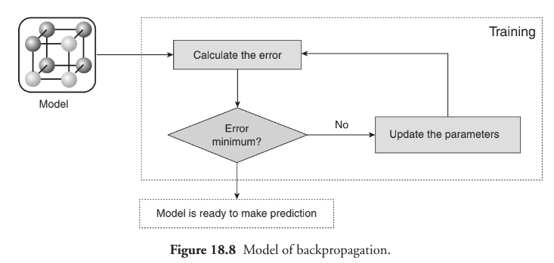
18.1 Introduction 18.2 Basic Models of Artificial Neural Networks 18.3 First Artificial Neurons: McCulloch-Pitts Model 18.4 Neural Network Architecture 18.5 Single-Layer Feed-forward ANN 18.6 Multilayer Feed-forward ANN 18.7 Activation Functions 18.8 Supervised Learning 18.9 Delta Learning Rule 18.10 Back Propagation Algorithm
18.11 Unsupervised Learning Algorithm 18.12 Self-Organising Maps 18.13 Hybrid Approach : Fuzzy Neural Systems
Back Propagation Algorithm

Slide 66
18.1 Introduction 18.2 Basic Models of Artificial Neural Networks 18.3 First Artificial Neurons: McCulloch-Pitts Model 18.4 Neural Network Architecture 18.5 Single-Layer Feed-forward ANN 18.6 Multilayer Feed-forward ANN 18.7 Activation Functions 18.8 Supervised Learning 18.9 Delta Learning Rule 18.10 Back propagation
18.11 Unsupervised Learning
18.12 Self-Organising Maps 18.13 Hybrid Approach : Fuzzy Neural Systems
Unsupervised Learning
The other type of training is known as unsupervised training. The network is provided with the desired outputs in the unsupervised training. The system is responsible for deciding the features used by it to group the input data. This kind of data is generally known as self-organisation or adaption.

Slide 67
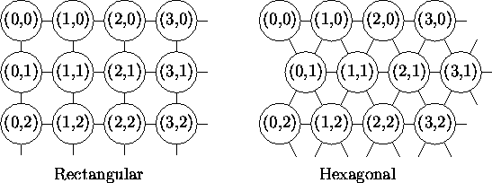
18.1 Introduction 18.2 Basic Models of Artificial Neural Networks 18.3 First Artificial Neurons: McCulloch-Pitts Model 18.4 Neural Network Architecture 18.5 Single-Layer Feed-forward ANN 18.6 Multilayer Feed-forward ANN 18.7 Activation Functions 18.8 Supervised Learning 18.9 Delta Learning Rule 18.10 Back propagation
18.11 Unsupervised Learning
18.12 Self-Organising Maps 18.13 Hybrid Approach : Fuzzy Neural Systems
Self-Organising Maps
The Self-Organizing Map is one of the most popular neural network models. It belongs to the category of competitive learning networks. The Self-Organizing Map is based on unsupervised learning, which means that no human intervention is needed during the learning and that little needs to be known about the characteristics of the input data.

Slide 68
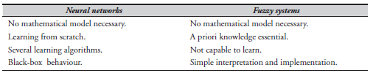
18.1 Introduction 18.2 Basic Models of Artificial Neural Networks 18.3 First Artificial Neurons: McCulloch-Pitts Model 18.4 Neural Network Architecture 18.5 Single-Layer Feed-forward ANN 18.6 Multilayer Feed-forward ANN 18.7 Activation Functions 18.8 Supervised Learning 18.9 Delta Learning Rule 18.10 Back propagation
18.11 Unsupervised Learning
18.12 Self-Organising Maps 18.13 Hybrid Approach : Fuzzy Neural Systems
Fuzzy neural system
A fuzzy neural network (FNN) or neuro-fuzzy system is a learning machine that identifies the parameters of a fuzzy system (fuzzy sets, fuzzy rules) by exploiting approximation techniques from the neural networks.
Comparison between fuzzy network and neural system

Slide 69
18.1 Introduction 18.2 Basic Models of Artificial Neural Networks 18.3 First Artificial Neurons: McCulloch-Pitts Model 18.4 Neural Network Architecture 18.5 Single-Layer Feed-forward ANN 18.6 Multilayer Feed-forward ANN 18.7 Activation Functions 18.8 Supervised Learning 18.9 Delta Learning Rule 18.10 Back propagation
18.11 Unsupervised Learning
18.12 Self-Organising Maps 18.13 Hybrid Approach : Fuzzy Neural Systems
Characteristics
1. A neuro-fuzzy system is on the basis of an underlying fuzzy system is trained by means of a data-driven earning method obtained from the neural network theory. This heuristic takes into account only the local information to cause local changes in the fundamental fuzzy system.
2. It can also be represented as a set of fuzzy rules at any time of the learning process, that is, before, during and after.
(a) Thus, the system might be initialised with or without a prior knowledge with respect to the fuzzy rules.
3. The learning procedure is constrained to ensure the semantic properties of the underlying fuzzy system.
4. A neuro-fuzzy system approximates n-dimensional unknown function.

Slide 70
18.1 Introduction 18.2 Basic Models of Artificial Neural Networks 18.3 First Artificial Neurons: McCulloch-Pitts Model 18.4 Neural Network Architecture 18.5 Single-Layer Feed-forward ANN 18.6 Multilayer Feed-forward ANN 18.7 Activation Functions 18.8 Supervised Learning 18.9 Delta Learning Rule 18.10 Back propagation
18.11 Unsupervised Learning
18.12 Self-Organising Maps 18.13 Hybrid Approach : Fuzzy Neural Systems
Characteristics
Thus, the fuzzy rules can be interpreted as the vague prototypes of the training data.
5. A neuro-fuzzy system is represented as a special three-layer feedforward neural network
(a) The first layer corresponds to the input variables.
(b) The second layer is symbolic of the fuzzy rules.
(c) The third layer shows the output variables.
(d) The fuzzy sets are converted as (fuzzy) connection weights.
(e) Some approaches also use five layers, where the fuzzy sets are encoded in the units of the second and the fourth layer, respectively. However, these models can be transformed into three-layer architecture.

Slide 71
18.1 Introduction 18.2 Basic Models of Artificial Neural Networks 18.3 First Artificial Neurons: McCulloch-Pitts Model 18.4 Neural Network Architecture 18.5 Single-Layer Feed-forward ANN 18.6 Multilayer Feed-forward ANN 18.7 Activation Functions 18.8 Supervised Learning 18.9 Delta Learning Rule 18.10 Back propagation
18.11 Unsupervised Learning
18.12 Self-Organising Maps 18.13 Hybrid Approach : Fuzzy Neural Systems
Characteristics
Types of FNNs
Cooperative
Concurrent
Hybrid

Slide 72
Dr. Nilakshi Jain Email ID : nilakshijain1986@gmail.com
Thank you

